Slide 1
SUPERVISED LEARNING

Slide 2

WHAT WILL WE COVER?
Recap of what is supervised learning
Core Concepts required
Classification Algorithms
Regression Algorithms
Data Squad | Supervised Learning

Slide 3
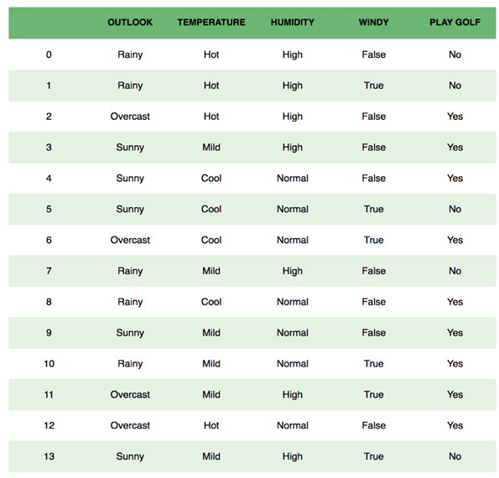
SUPERVISED: SHOULD I PLAY GOLF?
The objective is to predict if based on the weather conditions of a particular day, we should go play Golf?
Data Squad | Supervised Learning

Slide 4
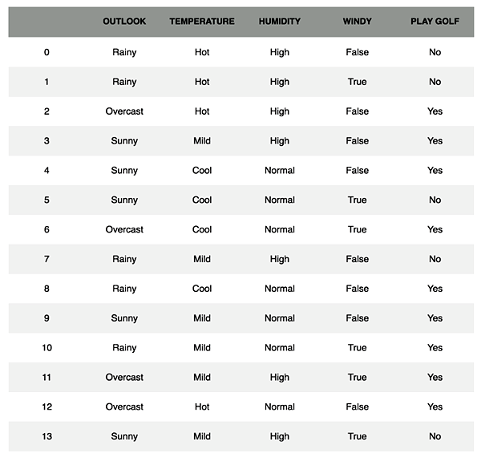
SUPERVISED: SHOULD I PLAY GOLF?
But how does my algorithm learn?
Based on past datapoints!!!
This is the "Supervised" component
These are called the labels
Supervised Learning is performed on labelled data
Data Squad | Supervised Learning

Slide 5

THE MACHINE LEARNING PROCESS
Labeled Data
Feature Engineering
Train-Test Split
Process of obtaining labeled data is tricky and many times the bottleneck of obtaining an efficient algorithm
Pick Algorithm & Hyperparameters
Optimize Parameters of Algorithm
Evaluate Algorithm with appropriate metric
Based on Loss Function
Data Squad | Supervised Learning

Slide 6
THE MACHINE LEARNING PROCESS
Labeled Data
Feature Engineering
Train-Test Split
See Previous Class
Pick Algorithm & Hyperparameters
Optimize Parameters of Algorithm
Evaluate Algorithm with appropriate metric
Based on Loss Function
Data Squad | Supervised Learning

Slide 7
THE MACHINE LEARNING PROCESS
Labeled Data
Feature Engineering
Train-Test Split
Can be done in a conventional way or with more advaned technique (balancing dataset or cross validation)
Pick Algorithm & Hyperparameters
Optimize Parameters of Algorithm
Evaluate Algorithm with appropriate metric
Based on Loss Function
Data Squad | Supervised Learning

Slide 8
THE MACHINE LEARNING PROCESS
Labeled Data
Feature Engineering
Train-Test Split
This is where you earn your salary. With experience you will have intuition of which algorithm will be best suited for your situation. The hyperparameters have to be set
Pick Algorithm & Hyperparameters
Optimize Parameters of Algorithm
Evaluate Algorithm with appropriate metric
Based on Loss Function
Data Squad | Supervised Learning

Slide 9
THE MACHINE LEARNING PROCESS
Labeled Data
Feature Engineering
Train-Test Split
Loss Function vs Cost Function
Attributes a Penalty to each incorrect prediction. Parameters are optimized to minimize this
Pick Algorithm & Hyperparameters
Optimize Parameters of Algorithm
Evaluate Algorithm with appropriate metric
Based on Loss Function
Data Squad | Supervised Learning

Slide 10
THE MACHINE LEARNING PROCESS
Labeled Data
Feature Engineering
Train-Test Split
Once we are happy with our algorithm training we need to see an appropriate evaluation metric to make our final judgement
Pick Algorithm & Hyperparameters
Optimize Parameters of Algorithm
Evaluate Algorithm with appropriate metric
Based on Loss Function
Data Squad | Supervised Learning

Slide 11
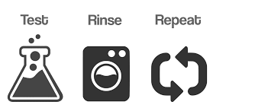
THE MACHINE LEARNING PROCESS
Labeled Data
Feature Engineering
Train-Test Split
Pick Algorithm & Hyperparameters
Optimize Parameters of Algorithm
Evaluate Algorithm with appropriate metric
Based on Loss Function
Data Squad | Supervised Learning

Slide 12
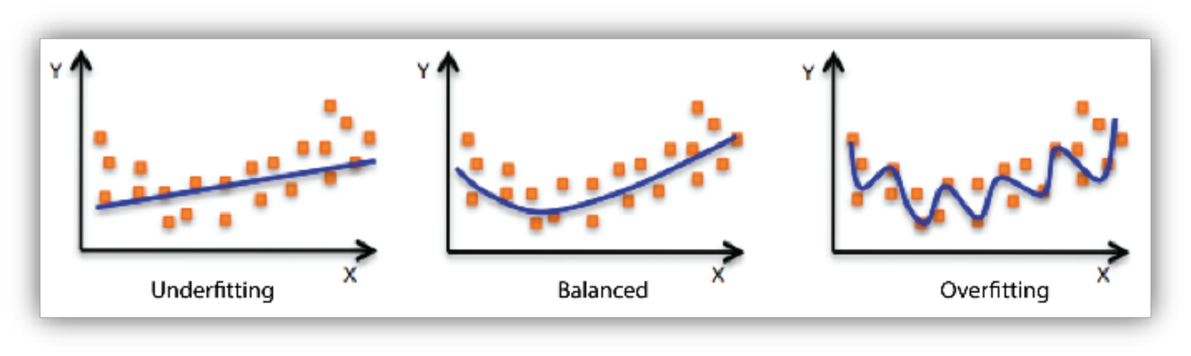
CLASSIFICATION ALGORITHMS
This is the biggest danger when creating machine learning algorithms
Underfitting: model is too simplistic
Overfitting: model adapts too much to the training data and does not generalize properly
Data Squad | Supervised Learning

Slide 13
CLASSIFICATION ALGORITHMS
Model Generelization is how well will the trained model perform on new unseen data?
This is why we perform the train-test split!!!
This way we give the algorithm some data to train, and then a smaller sample to test how does the model behave on unseen data
Data Squad | Supervised Learning

Slide 14
CLASSIFICATION ALGORITHMS
KNN (Regression Friendly) (Multi Class)
Logistic Regression
Decision Trees (Regression Friendly) (Multi Class)
Naive-Bayes Classifier (Multi Class)
Support Vector Machine (SVM)
Data Squad | Supervised Learning

Slide 15
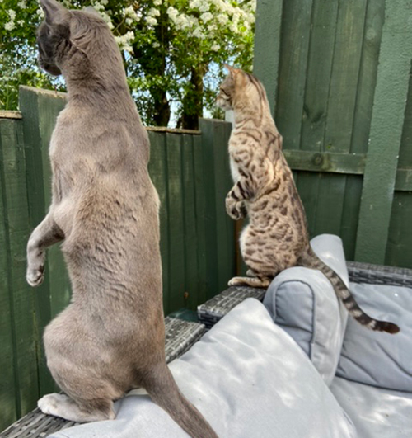
K NEAREST NEIGHBOURS
K- Nearest Neighbours (KNN)
The Copy-Cat of the Neighbours
Hyperparameters:
K - # of neighbours
Method of weight of neighbours
Data Squad | Supervised Learning

Slide 16
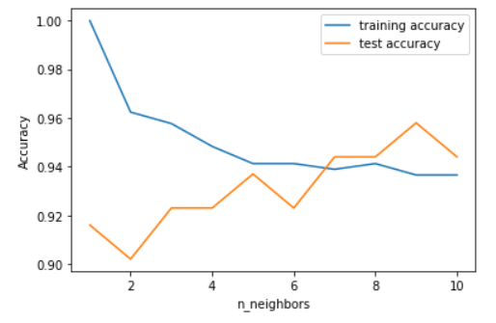
K NEAREST NEIGHBOURS
Example of Overfitting and training vs test tradeoff
go to colab
Data Squad | Supervised Learning

Slide 17
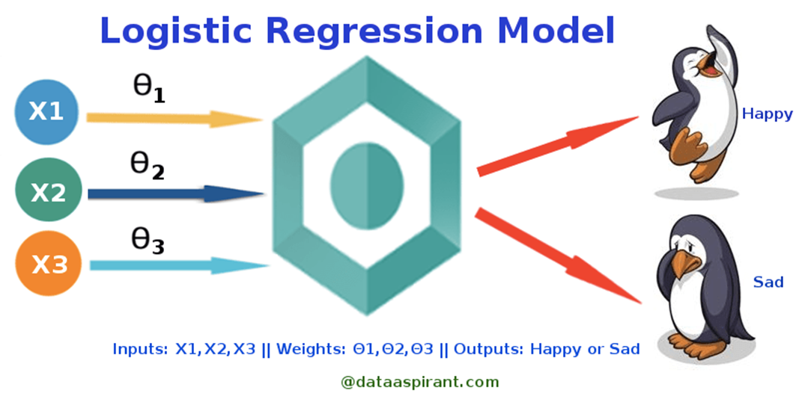
LOGISTIC REGRESSION
Binary Classification Algorithm
Takes in numerical inputs and
Hyperparameter: Decision Boundary
Data Squad | Supervised Learning

Slide 18
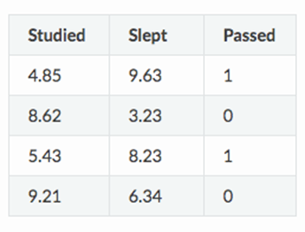
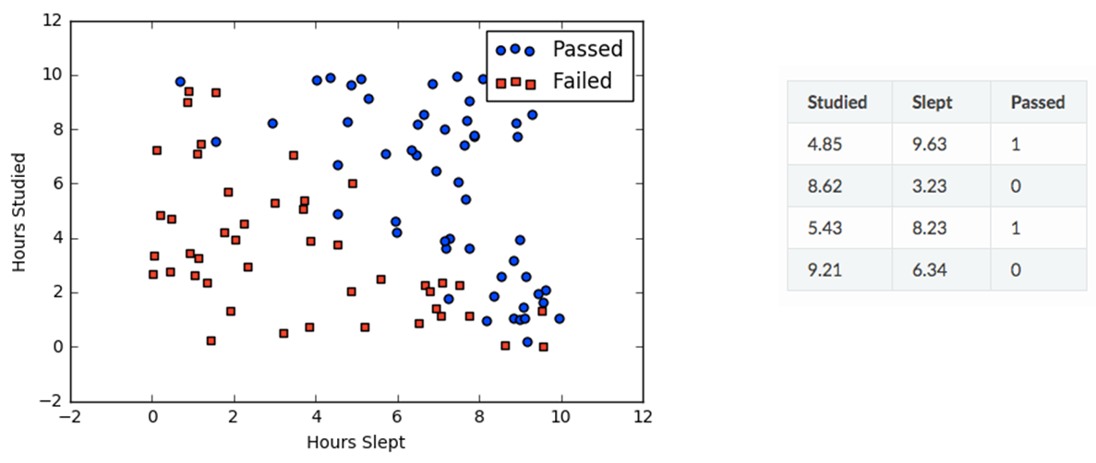
LOGISTIC REGRESSION
Steps:
Perform usual linear Regression
Pass result through sigmoid function
Compare result to decision boundary
Make Prediction
Data Squad | Supervised Learning

Slide 19

LOGISTIC REGRESSION - LINEAR REGRESSION STEP
Here there is the need to optimize the parameters of the linear regression
But do we compare z directly to something?
NO
Data Squad | Supervised Learning

Slide 20
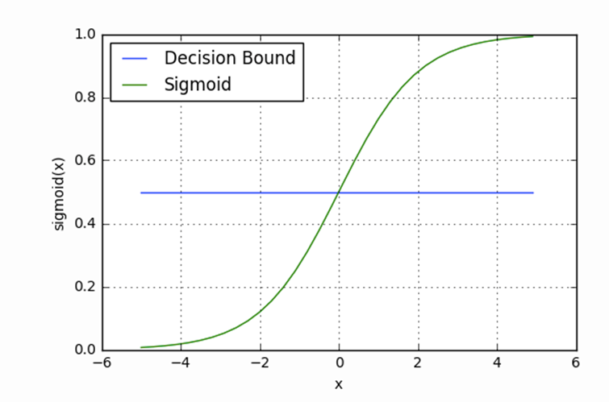
LOGISTIC REGRESSION - SIGMOID FUNCTION
This is where things become Nonlinear
Data Squad | Supervised Learning

Slide 21
LOGISTIC REGRESSION
Data Squad | Supervised Learning

Slide 22

LOGISTIC REGRESSION
Data Squad | Supervised Learning

Slide 23

LOGISTIC REGRESSION - SIGMOID FUNCTION
This is where things become Nonlinear
z
z
Sigmoid(z)
z
Data Squad | Supervised Learning

Slide 24

LOGISTIC REGRESSION - SIGMOID FUNCTION
Class 1
Sigmoid(z)
Decision Boundary
Class 0
z
Data Squad | Supervised Learning

Slide 25
LOGISTIC REGRESSION - SIGMOID FUNCTION
For a set of the regression parameters, predictions are made and then compared with labels
Class 1
Sigmoid(z)
Decision Boundary
instead of maximising the # of correct answers, ML algos usually try to minimize the # errors...
Class 0
z
Data Squad | Supervised Learning

Slide 26
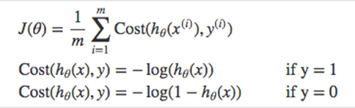
LOGISTIC REGRESSION - SIGMOID FUNCTION
For a set of the regression parameters, predictions are made and then compared with labels
Class 1
Sigmoid(z)
Decision Boundary
Cost Function is used to evaluate "Penalty"
Class 0
z
Data Squad | Supervised Learning

Slide 27
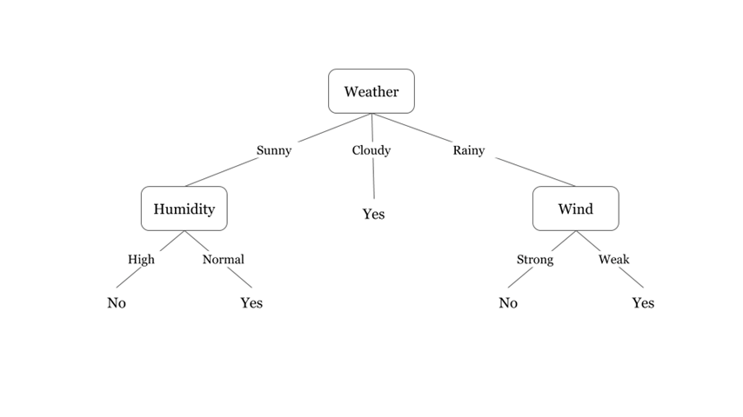
DECISION TREES
- Each level of the tree asks a "question" about a specific feature and divides the paths into several nodes
- number of levels is known as the tree depth
- Trees are constructed by trying different combinations of features
Data Squad | Supervised Learning

Slide 28

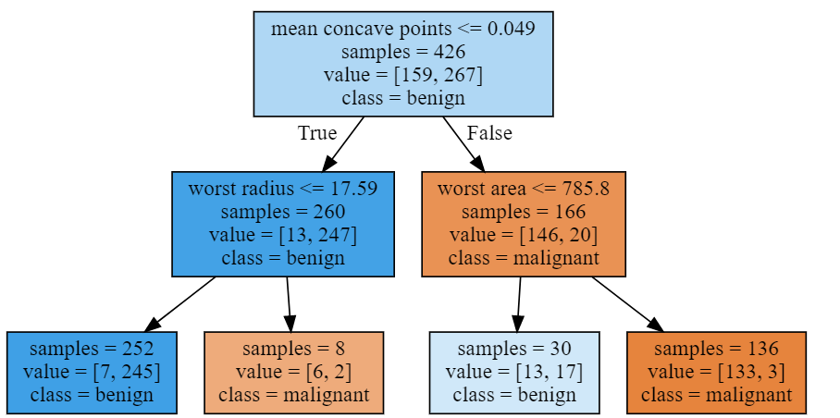

DECISION TREES
Very simple to build and train
Very robust to different types of features
Quickly Overfit if hyperparameters are not controlled
Generalization Problems: what happens if feature outside possible ranges appears?
Online Learning problem: quickly change when re-trained
Data Squad | Supervised Learning

Slide 29
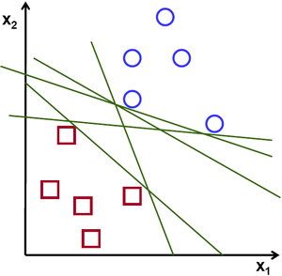
SUPPORT VECTOR MACHINE (SVM)
Data Squad | Supervised Learning

Slide 30
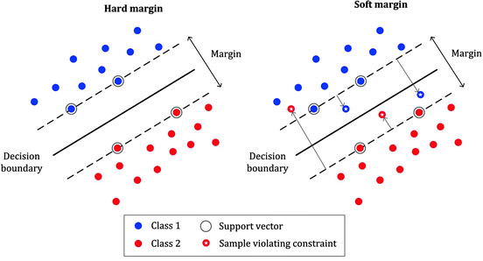
SUPPORT VECTOR MACHINE (SVM)
Our objective is to find a plane that has the maximum margin, i.e the maximum distance between data points of both classes. Maximizing the margin distance provides some reinforcement so that future data points can be classified with more confidence.
Data Squad | Supervised Learning

Slide 31
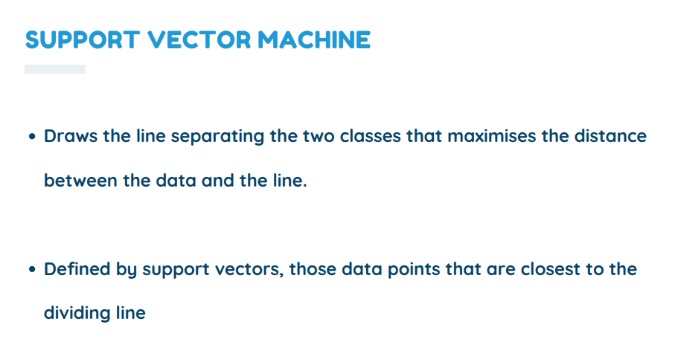
Data Squad | Supervised Learning

Slide 32
SVM
Can Model NonLinear Boundaries (if nonlinear version is used)
Unlikely to overfit
Memory intensive: is more successful on small dataset
Data Squad | Supervised Learning

Slide 33
CROSS VALIDATION
Just to make the process more confusing!
Currently we've learnt that the train-test split is performed in a random way.
But are we leaving information on the table? How do we know a super representative point is being placed in the test dataset thus not allowing our algorithm to "learn"?
This is where Cross Validation comes in
Cros Validation is the process of performing several different test-train splits
Data Squad | Supervised Learning

Slide 34

CROSS VALIDATION
Currently we've learnt that the train-test split is performed in a random way.
But are we leaving information on the table? How do we know a super representative point is being placed in the test dataset thus not allowing our algorithm to "learn"?
This is where Cross Validation comes in
Cros Validation is the process of performing several different test-train splits
Data Squad | Supervised Learning

Slide 35
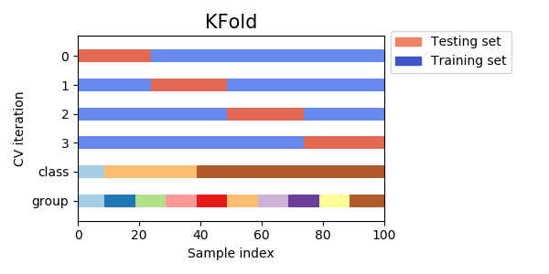
CROSS VALIDATION
K-Fold Cross Validation
This is the simplest Cross Validation technique whereby data is split into k times into different Test-Train splits always preserving the length of each
Data Squad | Supervised Learning

Slide 36
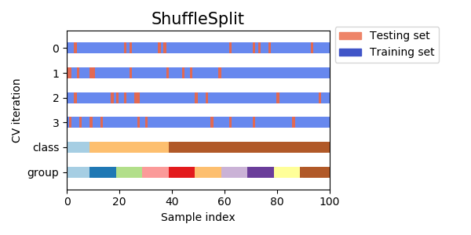
CROSS VALIDATION
Shuffle Split Cross Validation
Performing a shuffled split further ensures more randomness is created when performing the split
Data Squad | Supervised Learning

Slide 37
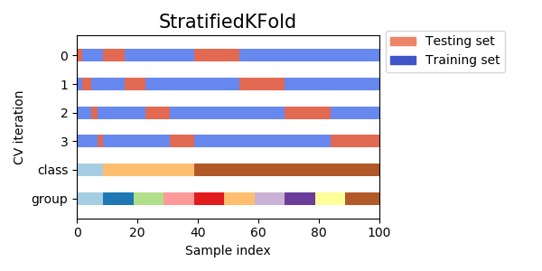
CROSS VALIDATION
Stratified KFold
Whenever you have a severe class imbalance you may want to perform stratified sampling: you create your splits always preserving the same ratio of each class types (1/10)
Data Squad | Supervised Learning

Slide 38
CROSS VALIDATION
How about the train-testing process for time series data?
Consider the problem if we used K-Fold
Data Squad | Supervised Learning

Slide 39
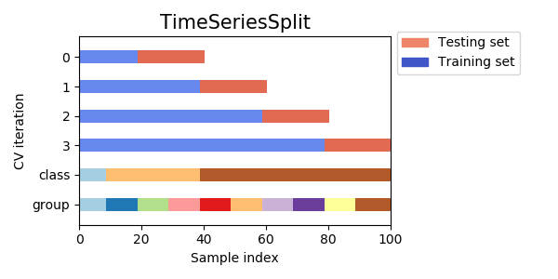
CROSS VALIDATION
How about the train-testing process for time series data?
Super common mistake that I see in using Time Series Data is to use data from the future to build a model to predict the past!!
Data Squad | Supervised Learning

Slide 40
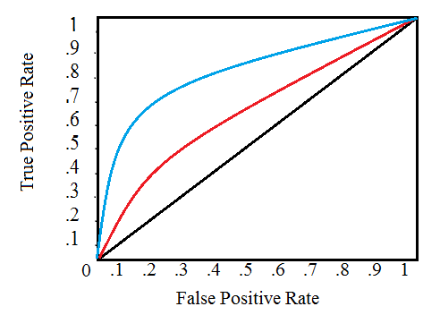
PERFORMANCE EVALUATION METRICS - ROC CURVE
It is a plot of the false positive rate (x-axis) versus the true positive rate (y-axis) for a number of different candidate threshold values between 0.0 and 1.0. Put another way, it plots the false alarm rate versus the hit rate.
Data Squad | Supervised Learning

Slide 41
ANY QUESTIONS ?

